Slide 1

Welcome
Everyone!!!

Slide 2
Hiring Manager & Support Staff Training
Dayforce Recruitment Transition Training
Department of Personnel Management
Live Date
June 09, 2026

Slide 3
Training Agenda
Welcome and Introduction
Overview of the Dayforce Recruitment Transition
Recruitment Process Changes and Expectations
Step-by-Step Job Requisition Process
Viewing and Managing Candidates in Dayforce
System Demonstration (Core & Advanced Features)
Key Dates, Deadlines, and Responsibilities
Questions, Comments, and Support Resources
Faryn Garcia HR Recruitment Manager
Latreva Largo Senior HR Analyst
Denise Brown HR Tech
Jennifer Tsosie HR Analyst
Darren Lizer Associate HR Analyst

Slide 4
Welcome & Introduction
The Department of Personnel Management (DPM) is transitioning recruitment operations into the Dayforce Recruitment Platform.
This transition is designed to streamline recruitment processes, improve efficiency, and centralize hiring activities.
Hiring Managers and Support Staff will play a critical role in ensuring a successful implementation.
This training will provide hands-on guidance and expectations for all users.

Slide 5
Purpose of the Transition
Replace
Replace the current fillable PDF Job Vacancy Announcement (JVA) process.
Eliminate
Eliminate the use of SharePoint for recruitment documentation and candidate tracking.
Centralize
Centralize recruitment workflows within Dayforce.
Improve
Improve transparency, compliance, and communication throughout the hiring process.
Provide
Provide real-time visibility into requisitions, candidate status, and approvals.

Slide 6
Recruitment Process Overview
Hiring Managers will initiate and submit job requisitions directly within Dayforce.
Approvals and recruitment workflows will be automated through the system.
Qualified candidate applications and attachments will be reviewed electronically.
Recruitment status updates will be accessible in real time.
Candidates will apply directly through the Navajo Nation Jobs Apply Portal

Slide 7
Key Changes for Hiring Managers
All job requisitions must be submitted using the Dayforce Recruitment module.
Manual PDF JVA forms will no longer be accepted after June 26th, 2026 deadline.
Hiring Managers and Support Staff must use assigned Dayforce security roles.
Candidate evaluations, notes, and recommendations must be documented within the system.
All recruitment-related records will be maintained electronically.

Slide 8
System Demonstration – Core Functions
Logging
Logging into Dayforce Recruitment
Creating and submitting
Creating and submitting a job requisition
Tracking
Tracking requisition approval status
Viewing
Viewing candidate applications and resumes
Filtering and reviewing
Filtering and reviewing qualified candidates
Communicating
Communicating with recruitment staff through the platform

Slide 9
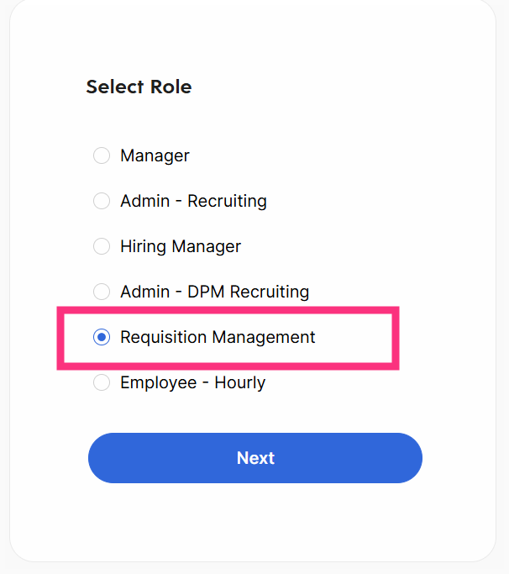
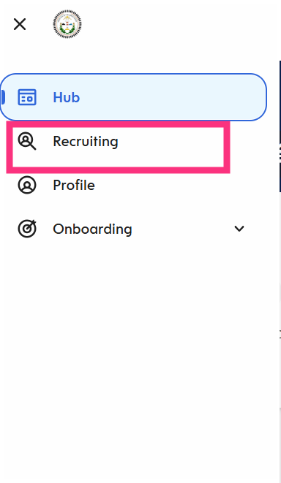

Slide 10
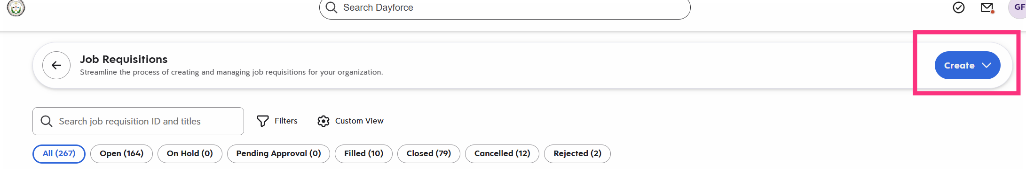
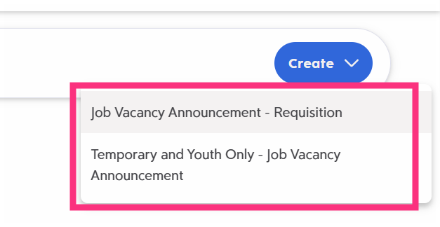
Select which Requisition needing to be advertised

Slide 11
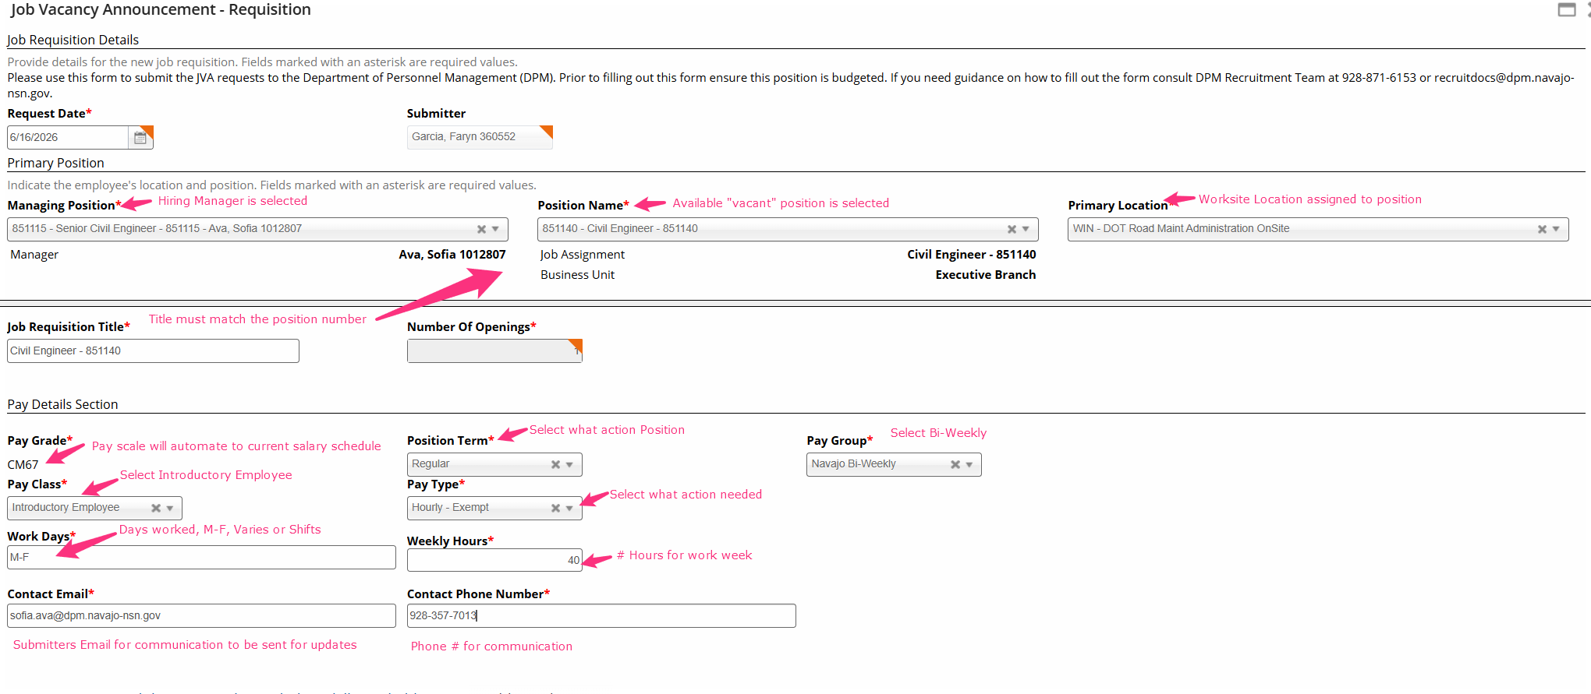

Slide 12
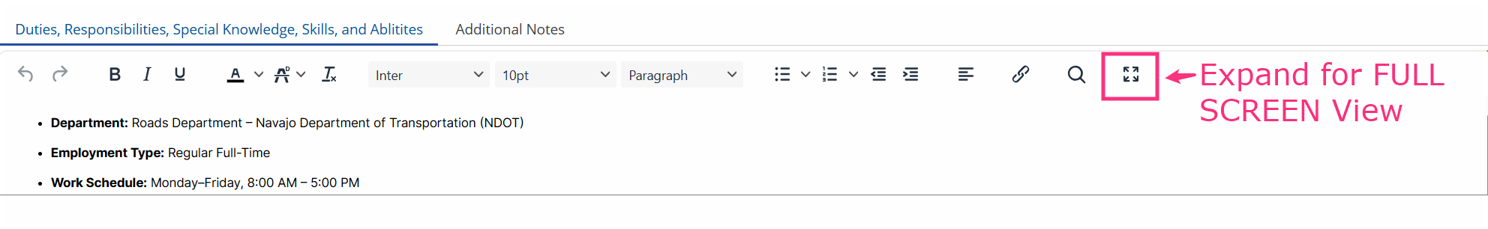
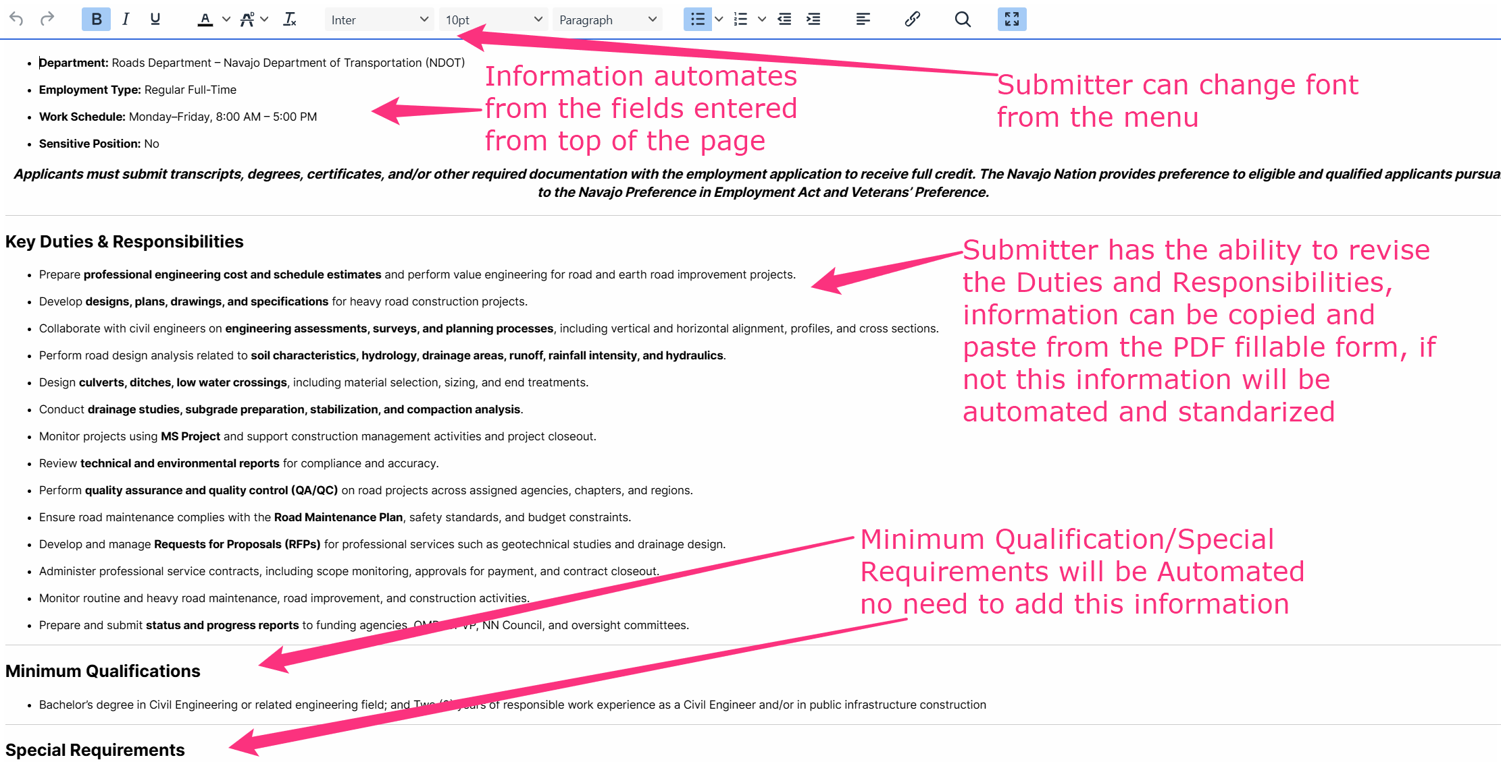

Slide 13
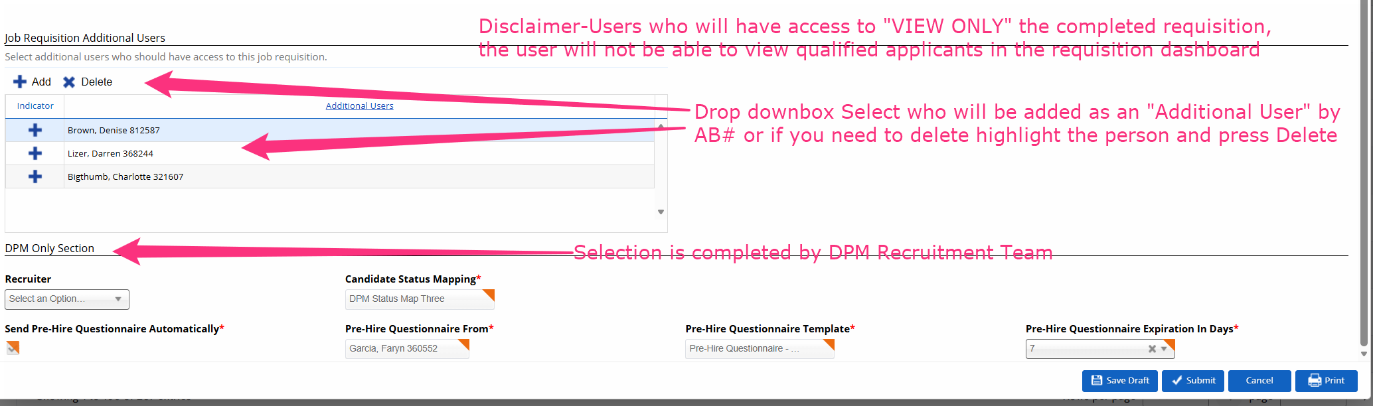
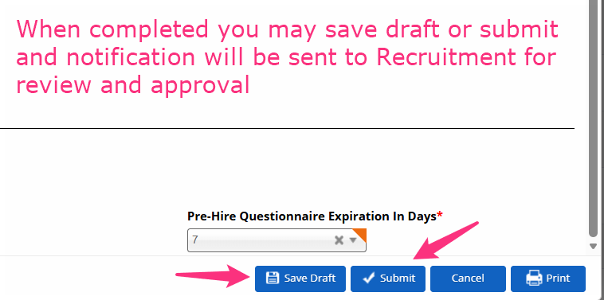

Slide 14
System Demonstration – Advanced Features
Real-time recruitment dashboard navigation
Candidate workflow tracking and status management
Document upload and management
Electronic approvals and audit tracking
Reporting and recruitment metrics
User role access and permissions

Slide 15
Walkthrough of the Recruitment Workflow
Step 1: Hiring Manager creates and submits requisition
Step 2: DPM Recruitment reviews and posts vacancy announcement
Step 3: Candidates apply through the Navajo Nation Jobs Apply Portal
Step 4: Hiring Manager reviews qualified applicants
Step 5: Interviews and selection process conducted
Step 6: Recruitment finalizes hiring documentation and onboarding

Slide 16
Timeline for hiring process
Step 1: Position is Vacant All vacant positions must be advertised for a minimum of 5 working days
Step 2: Within 10 days of the Vacancy, the Program creates and completes the Job Requisition Form and submits
Step 4: Job Requsition is advertised for a minimum of 5 business days.
Step 5: Requisition Closing date
Step 6: Within 5 business days of the closing req. QAs must be completed by DPM or Division Evaluators and referrals are sent to the Hiring Program
Step 8 : From the closing date to offer being made, should not exceed 15 business days COMMUNICATION IS KEY!!
Step 3 : DPM Recruitment reviews, returns or approves within 2 business days.
Step 7: Within 10 business days of receiving referrals, Hiring program must complete interviews, reference checks, and make a hiring selection.

Slide 17
Key Dates & Deadlines
Go-Live Date: June 9th, 2026
Training Sessions Scheduled: May 26, May 28th, June 2 and June 4
System testing and implementation activities completed prior to launch
Last Day to Submit Fillable PDF JVA Forms: June 26, 2026
All recruitment actions after June 26, must be completed in Dayforce

Slide 18
Hiring Manager Responsibilities
Ensure
Ensure all recruitment requests are submitted accurately and timely within Dayforce.
Review
Review candidate applications and supporting documents within the system.
Maintain
Maintain communication with DPM Recruitment regarding recruitment needs and updates.
Adhere
Adhere to recruitment timelines, approvals, and compliance requirements.
Participate in
Participate in all required training sessions and system practice exercises.

Slide 19
Support Staff Responsibilities
Assist Hiring Managers with requisition preparation and submission.
Monitor recruitment workflows and status updates.
Ensure supporting documentation is uploaded correctly.
Coordinate scheduling and communication activities as needed.
Support compliance and records management within Dayforce.

Slide 20
Benefits of Dayforce Recruitment
Improved recruitment efficiency and processing time
Centralized and secure recruitment documentation
Enhanced transparency and accountability
Reduced paper-based and manual processes
Improved collaboration between Hiring Managers and Recruitment Staff
Real-time recruitment tracking and reporting

Slide 21

Questions, Comments & Support
Questions regarding system access or training can be directed to the Department of Personnel Management.
Additional training materials and step-by-step guides will be provided.
Practice sessions and webinars will be available for continued support.
Ongoing technical assistance will be provided during the transition period.
Any additional questions or further information – Contact (928) 357-7013 or email recruitdocs@dpm.navajo-nsn.gov

Slide 22

Thank You
Thank you for participating in the Dayforce Recruitment Training.
Your cooperation and support are essential for a successful transition.

